Slide 1






PollBuddy
December 10th, 2019
PM: Shweta
Frontend: Anusahana, Gustav, Neha, and Nicholas
Backend: Alex, Hunter, Joe
Notes:
Neha

Slide 2
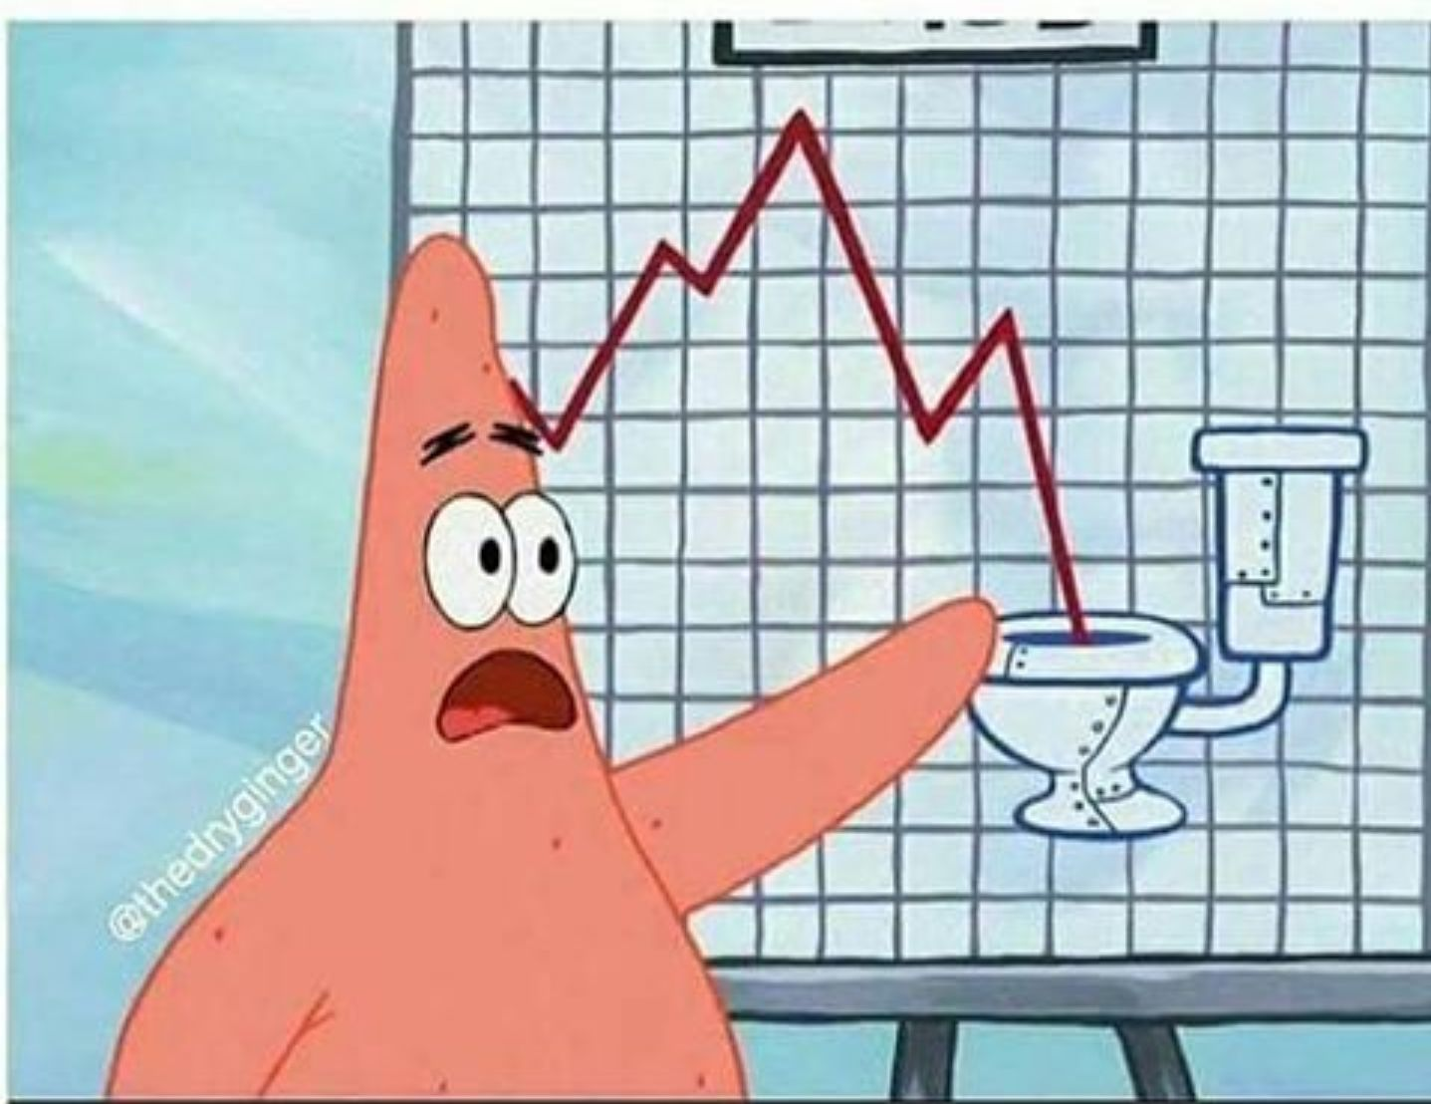

What is PollBuddy?
Website alternative to iClickers
“Virtual Classroom”
Affordable, easy-to-use, and interactive
Customizable teacher and student views
Integratable with Submitty and other RPI platforms
Notes:
Shweta

Slide 3

PollBuddy Info
Time goal of the project: minimum viable product by next semester
Repo: https://github.com/PollBuddy/PollBuddy
Notes:
Shweta

Slide 4
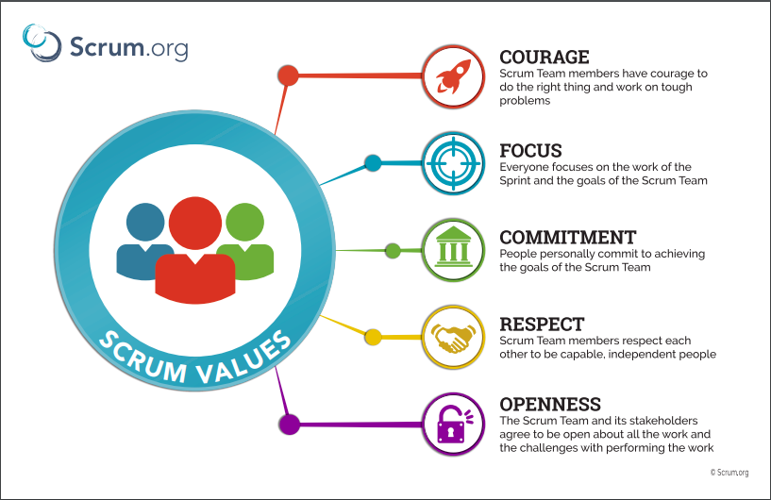
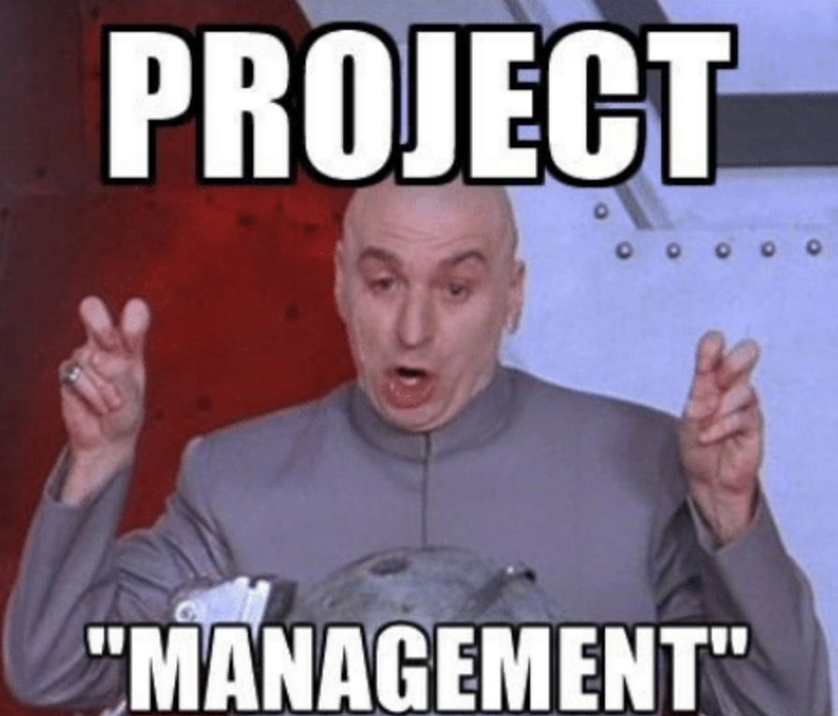
Managing the Project
Milestones were broken down into Deliverables and Action Items
Implemented Scrum
Notes:
Shweta

Slide 5
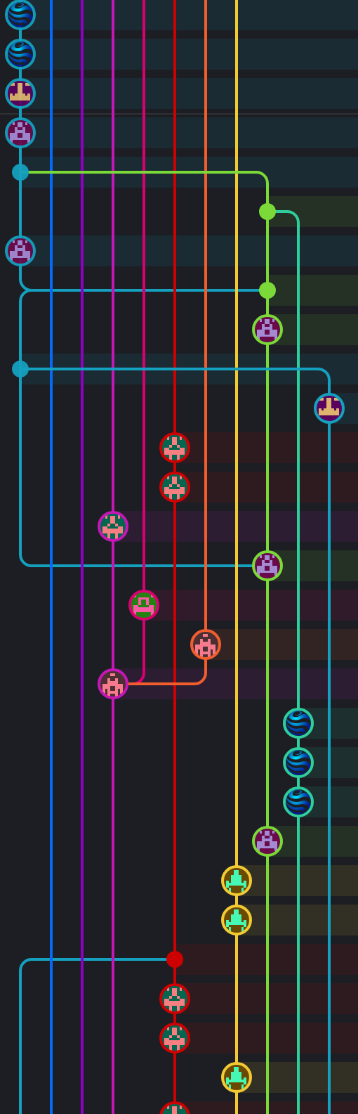
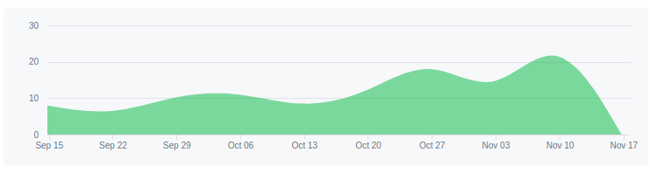
Repo Stats
156 Total Commits (updated as of today)
Contributions to master, excluding merge commits:
Notes:
Shweta

Slide 6
Front End
Notes:
Nick - Hello we are the front end of polly buddy.

Slide 7

Front End Goals
Home page
Login page
Teacher user interface
Student user interface
Lessons component
Notes:
Presenter: Nick

Slide 8


Frontend Milestones Overview
September
Planning: Decide on languages
Website with sample text
October
Rough UI
November
Complete UI: Lesson Page, Classroom Page
December
Minimum viable product, beta version ready for Spring testing
Notes:
Presenter: Gustav (Neha)

Slide 9
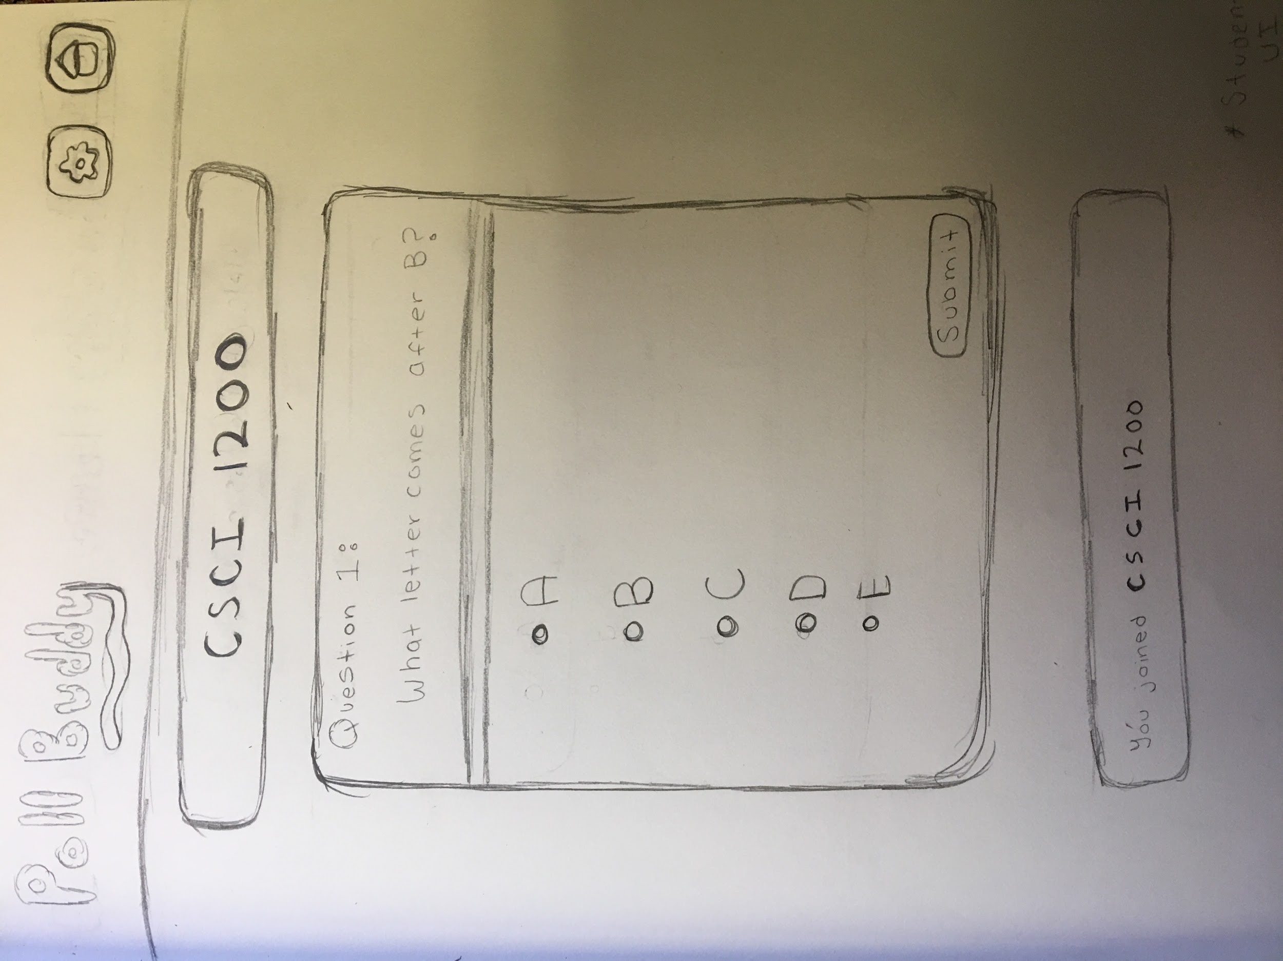
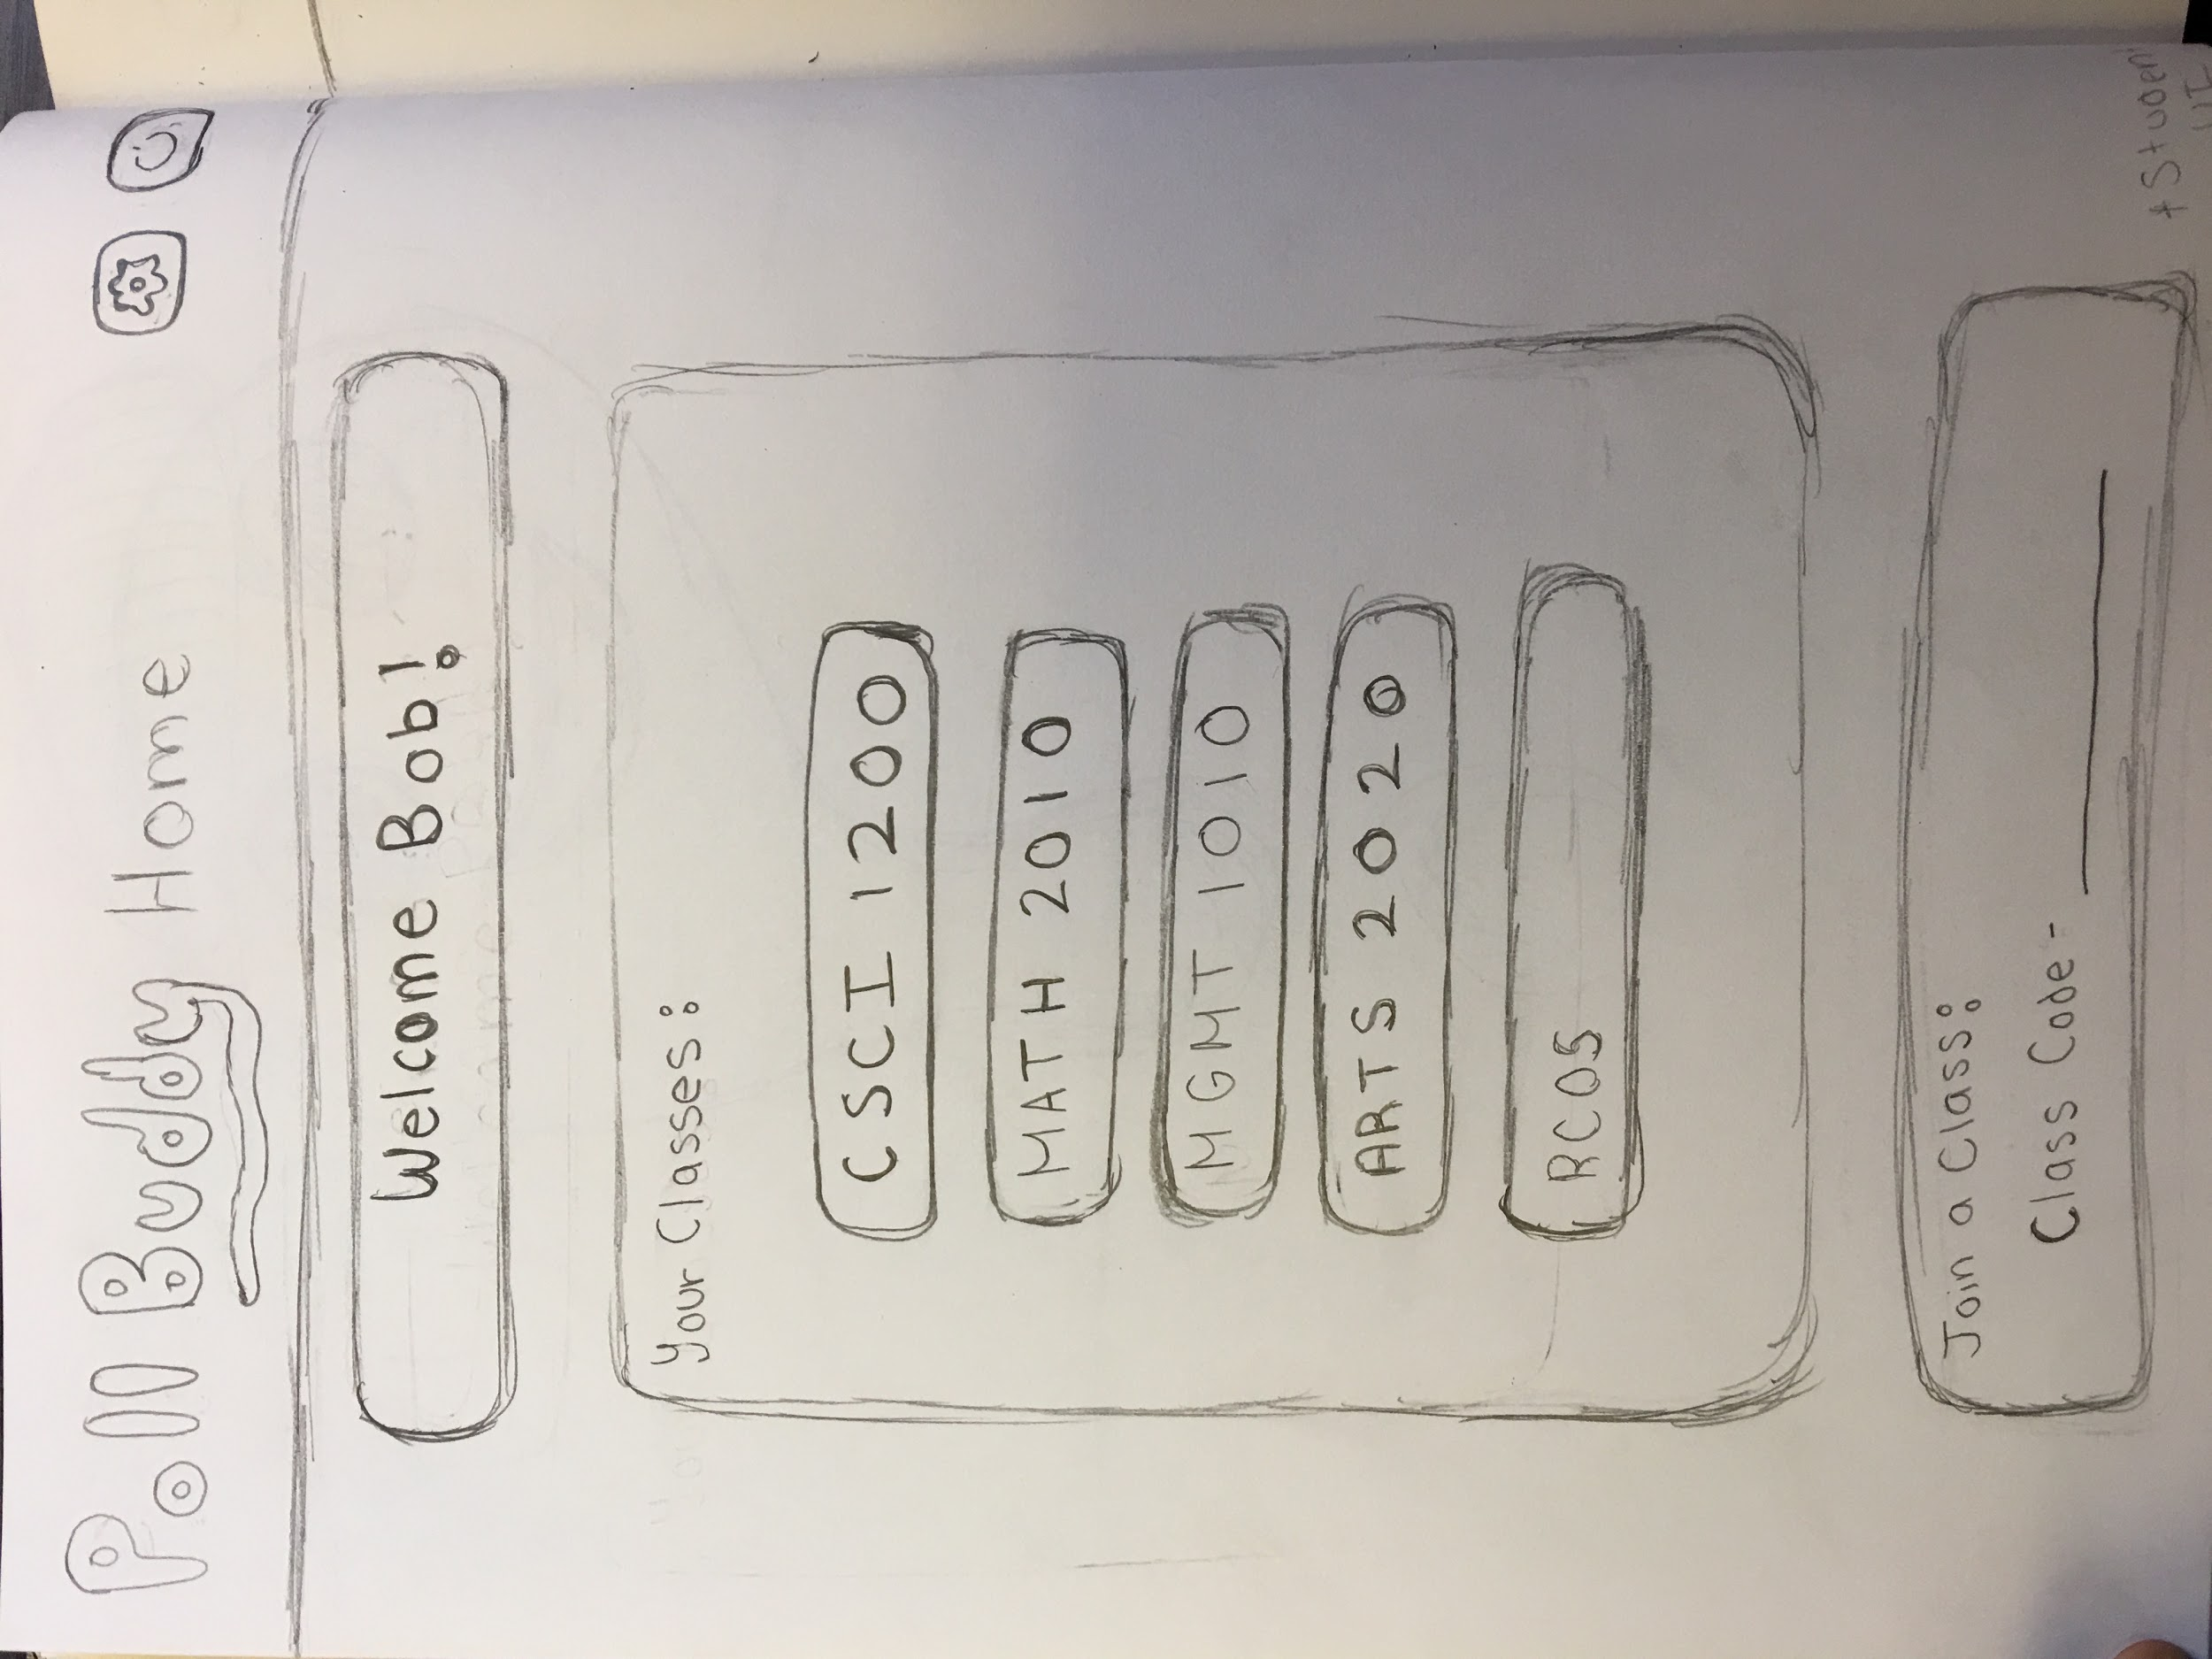
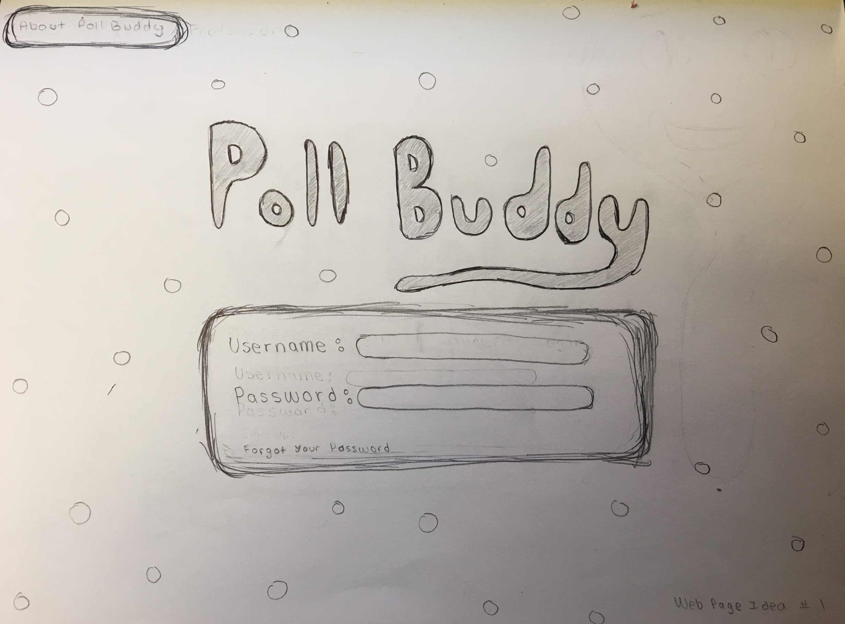
Web Page Designs
Lesson Page
My Classes Page
Sign In Page
Notes:
Presenter: Anu
Sign In Page
Users can enter their login details
My Classes Page
Shows a list of classes that users can click on to enter the classroom
Users also join a class with a class code and professors can create a class
Classroom Page
Area where students can see the questions that are posted
Professors can create questions here
Professors can post questions during their lecture since it’s easy for professors to create and post questions

Slide 10
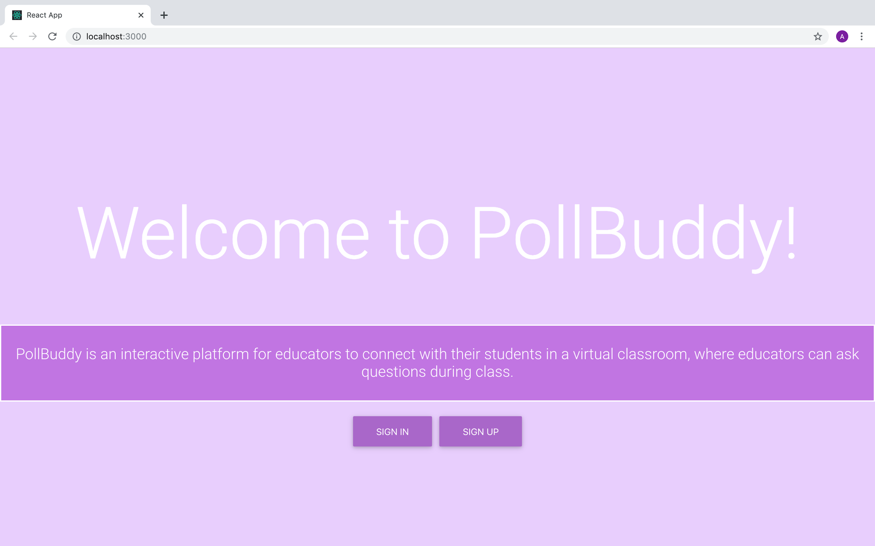
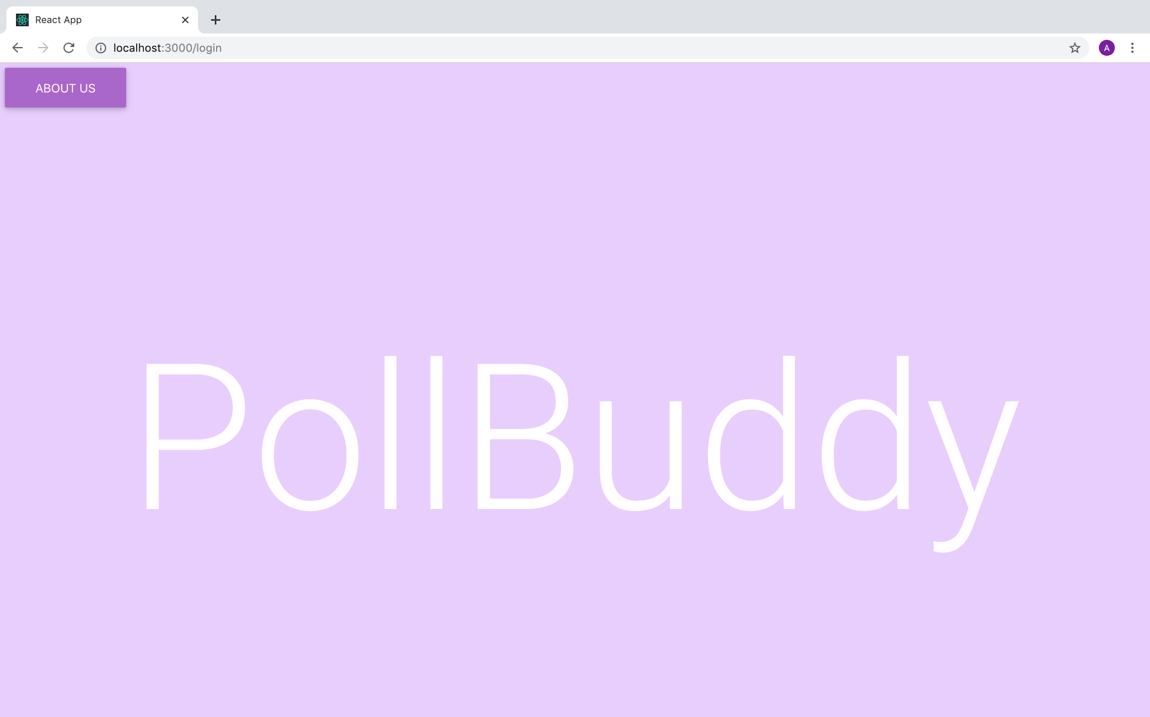
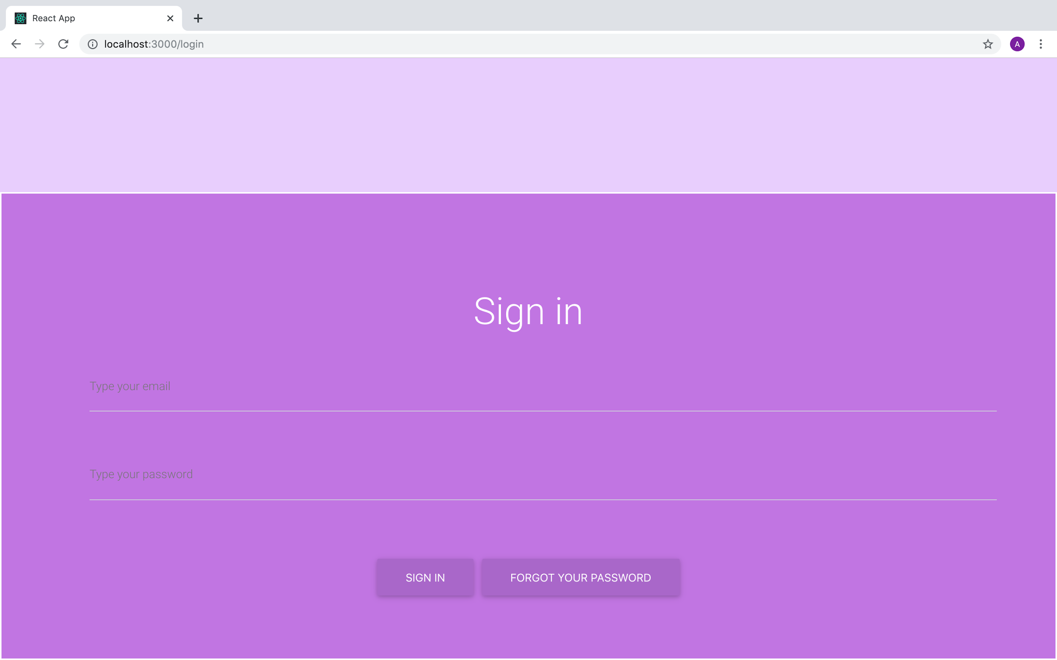
Home Page and Sign In Page
Landing Page
Sign In Page
Sign In Page
Notes:
Presenter: Anu
Home Page
Little description that introduces PollBuddy’s purpose
Users can then click Sign Up or Login
Login Page
Users can enter their information to get to the My Classes Page
Need to make these pages more accessible

Slide 11
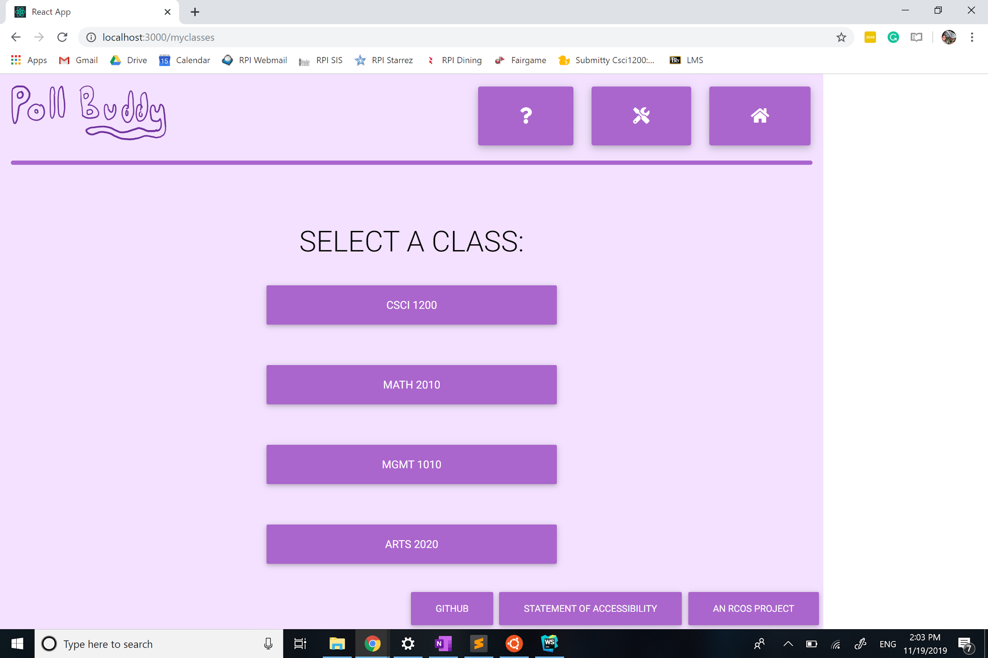
My Classes Page
Notes:
Presenter: Neha
After the user signs in this page
The user can select the class which goes to the lesson page
Logo on the top left
Menu on the top right
3 buttons that lead to external links

Slide 12
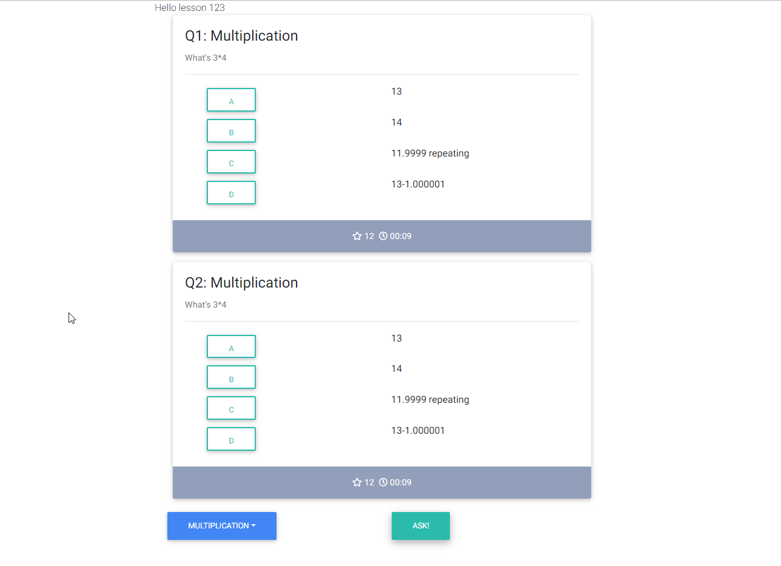
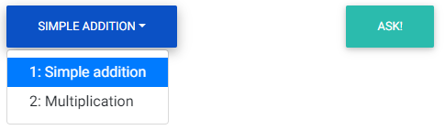
Lesson Page
Notes:
Presenter: Gustav (Nick)

Slide 13
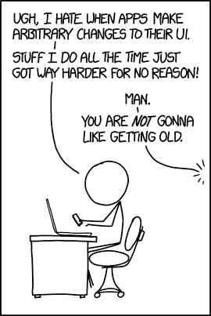
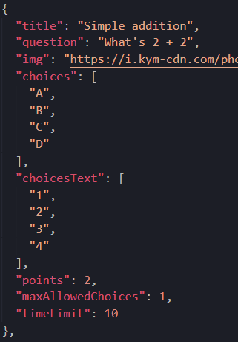
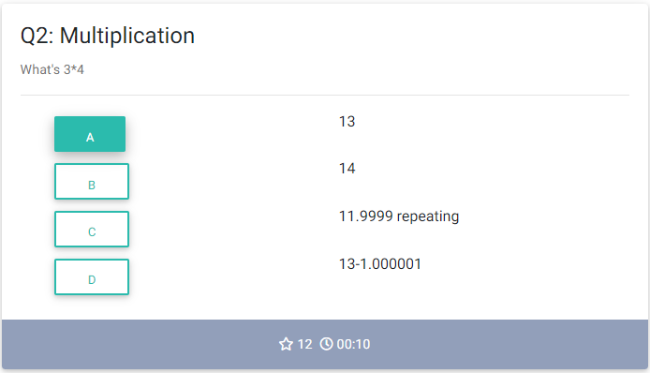
Question Component
Notes:
Presenter: Nick

Slide 14
Past Obstacles
Future Plans
Combine functionality with back end
Accessibility standards
Drop down menu
Interface of question component
Large learning curve
Improperly installed style sheets
Linking pages together
Notes:
Presenter: Neha
Since Poll Buddy was a new project this semester, we had obstacles
Inexperienced with react and github
Impartially installed style sheets
Discrepancy between pages
Led to problems linking pages together because everyone had different versions
-----
In the future we want to combine front end and back end
Accessibility standards
Fix our accessibility especially the color
More visually pleasing

Slide 15
Back End

Slide 16
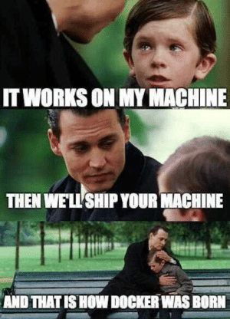
Docker
Container engine
Easy to develop/deploy on any environment
Self contained - independent of host OS
1 container per part of app
Frontend, Backend, Database
Tied together with Docker-Compose
1 command to package application together and run it
Minimal overhead
Simplifies setup and development
No need to fuss around installing Node, modules, MongoDB, etc. on your local machine
Notes:
Hunter
We started off our project by setting up Docker, which was something that I handled.
Docker is a container engine, which is basically a way to package an app into small sections that are easy to work with and reuse.
We designed our setup to have a container for each part of the app - frontend, backend, and the database, all tied together with docker-compose.
This gives us a simple single line command to package up and run the entire app all at once.
This simplifies development and deployment by doing all the setup work for you so you don’t have to worry about it.

Slide 17
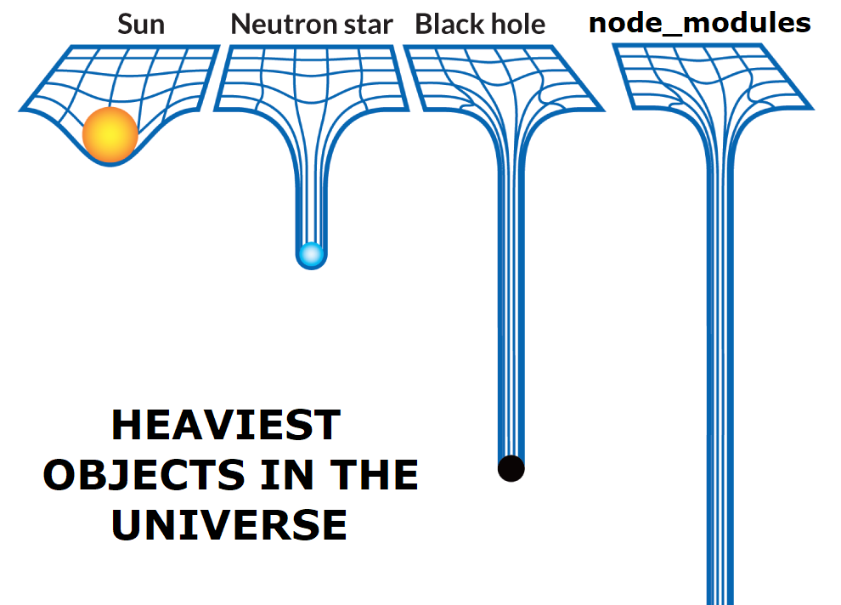
NodeJS
Platform to run JavaScript on your machine without a browser
Fast, asynchronous, extensive
Chosen because JavaScript is fairly easy to learn and use, and it’s a popular tool among modern web developers
Notes:
Hunter
We wanted something that would be pretty easy to use, but also something that was modern and fast, so we decided to try out NodeJS.
NodeJS is a platform to run javascript on your machine without a browser, and is fast, asynchronous, and extensive.
This lets us handle many requests at once and add a lot of complicated logic and features that otherwise would have been a lot harder to make.
Javascript is also pretty easy to learn since many of our team was new to it, and NodeJS is a popular tool umong modern web developers

Slide 18
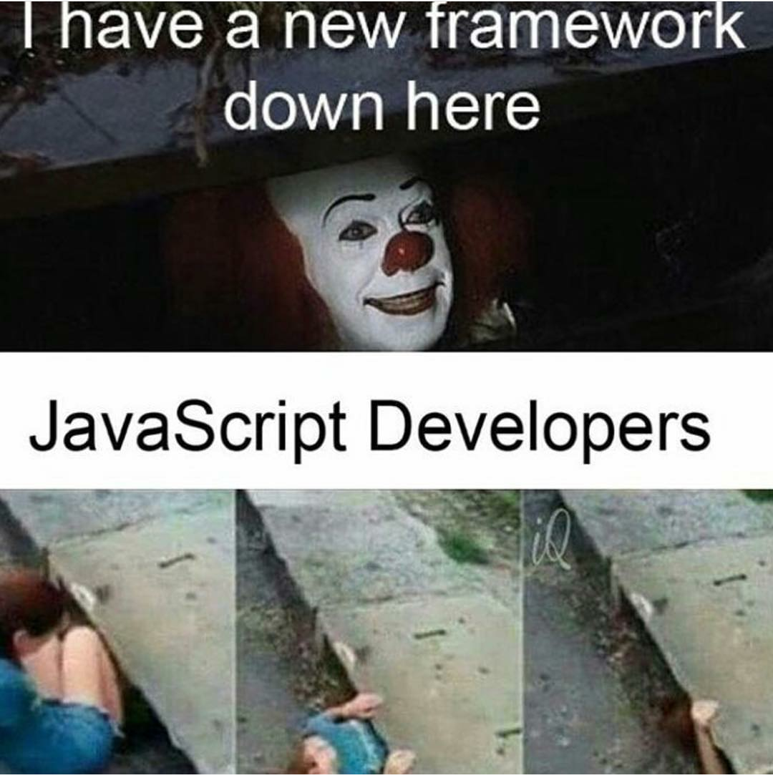
Express
Web framework for Node.js
Frameworks make it easy to add routes and use different HTTP verbs
Middleware can be used to add functionality such as authentication
Popular and extensible
Notes:
Alex
With Node.js we’re using the Express framework
Frameworks make it easier to implement routes and different HTTP verbs, which is a pain to do in native Node.js
Middleware are functions that are executed between the request and the response
Can be used for functionality such as authentication
Express is a popular framework, so there are plenty of third party middleware and functionality that can be easily implemented

Slide 19
Routes
Routing types:
GET
POST
Routers:
Groups
Polls
Users
Notes:
There are 2 types of routing used in pollBuddy get and post. We used three different routers for ease of use.

Slide 20
Group and Poll Routing
GET
/
/<ID>/
/<ID>/field/
MongoDB Database
Frontend
Backend
Q
Q
POST
/<ID>/edit/
/<ID>/delete/
Notes:
GET
Frontend specifies a route:
/ returns all objects; /<ID>/ returns all the information about the object with specified ID; /<ID>/field returns only the specified field about the object with the specified ID
POST
When using the edit route, a query json object has to be passed in and that json object contains an action property which determines if the backend will add or remove the other information on the query to the object
The delete route will simply delete the object with the ID from the database.

Slide 21
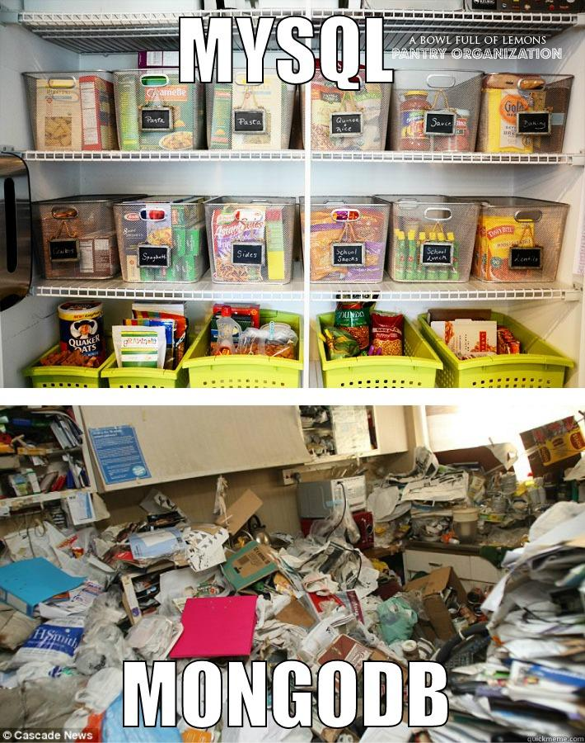
Database
MongoDB
Collections
groups
users
polls
poll_answers
Notes:
MongoDB keeps information stored in a usable manner, with autogenerated ID’s and tools to access and edit the data stored in it. All pertinent information on groups, users, polls and poll_answers are stored in their respective collections which are kept separate for usability.

Slide 22
Milestones
September Milestone: Planning
Deciding on software suite, languages, etc
Basic Docker containers and Compose scripts
October Milestone: Skeleton app
Extensive planning, documentation generation
Basic app setup through templates to fill in later
Files, routes, modules
Notes:
Hunter

Slide 23
Milestones
November Milestone: Filling it all in
Even more planning, documentation generation, tweaking
Creating sample data, visualization tools
MongoDB connection from backend Node app
Creating and implementing routes
/api/classes, /api/groups/, /api/users
Storing/Returning data to the client from the DB
Notes:
Hunter

Slide 24

Back End Future Goals
Users endpoint
Login (WIP)
Local and RCS
Details about user
Polls, groups, etc.
Scaling
CS1, Data Structures in DCC 308 with 500 people accessing PollBuddy at once
Aggregation functions
Generation of statistics and graphs about usage and polling results
Submitty integration
Anti-cheating
And much more! :D
Notes:
Alex
Still working on the users endpoint, which will facilitate authentication and user management
The application will need to be scalable to handle large entry level CS courses
Statistics so the professor can view overall performance in the course
Integration with submitty for easier/automatic grading
Anti-cheating since it would be easy to answer questions from anywhere

Slide 25

Thank You!

Slide 26

Questions?

